Slide 1
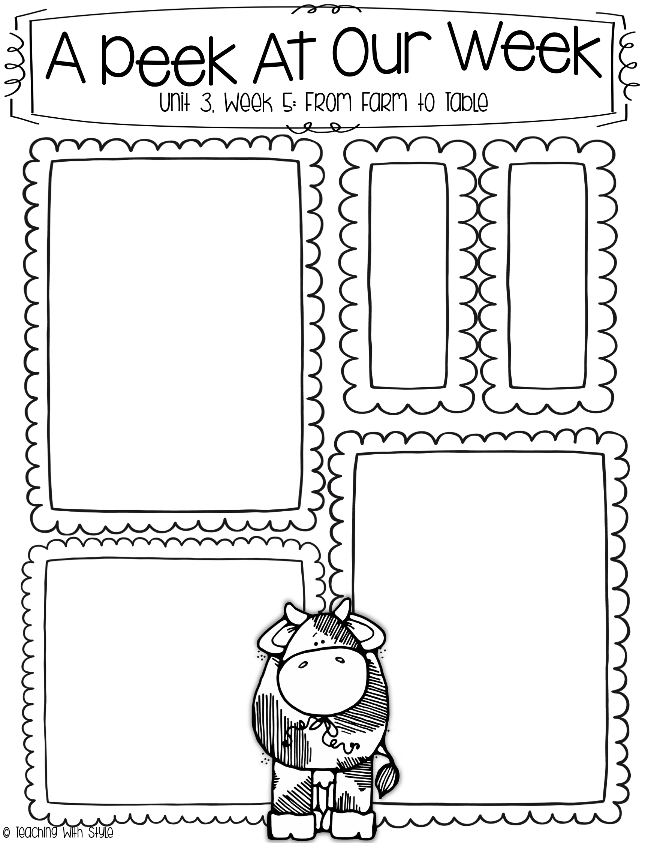
What we are learning!
Week of December 9th
Comprehension Focus:
sequence
Word Work:
oo, u, as in book and put
Inflectional Endings -ed, -ing
Grammar:
contractions with not
Math:
Topic 7 - number sequence
(Lessons 7.5-7.7)
Topic 7 Assessment will be given on Friday
Spelling Patterns
book
look
cook
took
hood
wood
High
Frequency
Words
after
buy
done
every
soon
work
Dates to Remember
December 18
First Grade Winter Program
2:00 in the cafeteria
December 20
Holiday Party
11:15 in our classroom
Holiday Spirit Days
12/16 Deck the Halls
12/17 Ugly Sweater Day
12/18 Holiday Cheer
12/19 Pajama Day
12/20 Merry GRINCHmas
Snacks for the week
Monday – Sabrina
Tuesday – Teigan
Wednesday – Isa
Thursday – Jack
Friday – Dalton
Please make sure that the
snacks are individually
wrapped. We have 20
students.

